Slide 1

Software Process Models Chap: 02 by Ian Somerville
Instructor Romasha Khurshid

Slide 2


Content:
Software process models
Process activities
Coping with change
The Rational Unified Process

Slide 3
The software process:
A structured set of activities required to develop a software system.
Many different software processes but all involve:
1.Specification
Defining what the system should do.
The idea of product is conceive.
3. Validation
checking that it does what the customer wants
2. Design and implementation Defining the organization of the system and implementing the system.
4. Evolution
changing the system in response to changing customer needs.

Slide 4
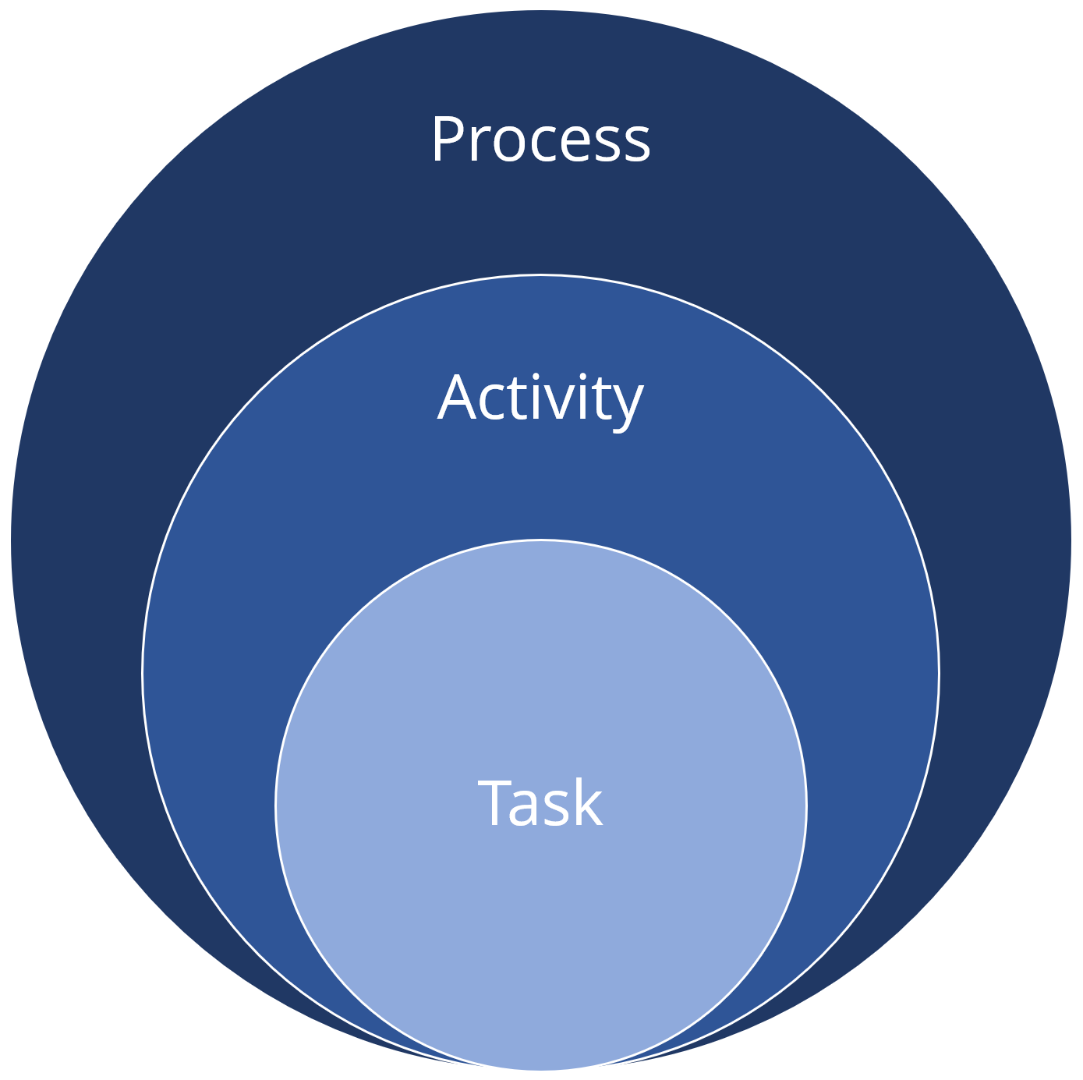
Software Process Descriptions:
When we describe and discuss processes, we usually talk about the activities in these processes such as specifying a data model, designing a user interface, etc. and the ordering of these activities.

Slide 5

Continue..
Process descriptions may also include:
Products, which are the outcomes of a process activity. i.e. Work Product
Roles, which reflect the responsibilities of the people involved in the process
Pre- and Post-conditions, which are statements that are true before and after a process activity has been enacted or a product produced.
Ex: A programmer
Tester
Product owner
client
CEO

Slide 6

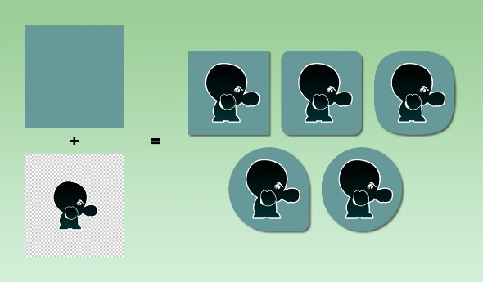
Plan-Driven and Agile Processes:
Plan-driven processes are processes where all of the process activities are planned in advance and progress is measured against this plan.
In agile processes, planning is incremental and it is easier to change the process to reflect changing customer requirements.
In practice, most practical processes include elements of both plan-driven and agile approaches.
There are no right or wrong software processes.
Predictive
Adaptive

Slide 7
Software process models

Slide 8
Software process models
The waterfall model
Incremental development
Integration and configuration
In practice, most large systems are developed using a process that incorporates elements from all of these models.

Slide 9
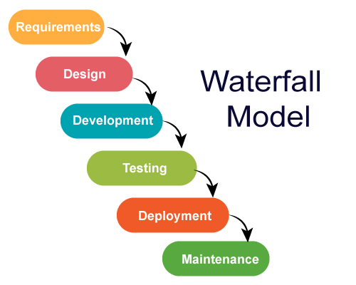
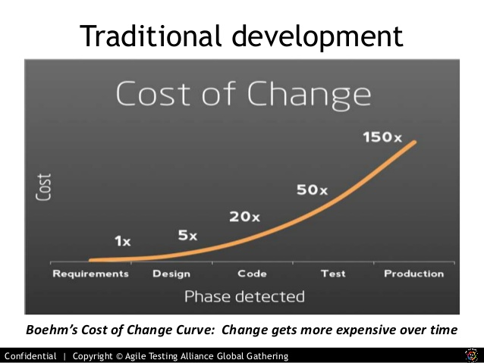
Waterfall (Traditional Approach)
Assumptions:
Requirements are very well understood.
Team has experience building similar projects (like ATM Machine).

Slide 10

Waterfall Model (Traditional Approach)
Pros:
Easy to understand and simple
Predictable
Efficient
Cons:
Not flexible for change
First release take a long time
A phase has to be complete before next phase (no back track)
Use:
Repeated Project
For Predictable project

Slide 11
Incremental development
Incremental Approach
Plan-driven
Increments identified in advance
Agile
Early increments are identified and later will be decided on customer priorities.

Slide 12
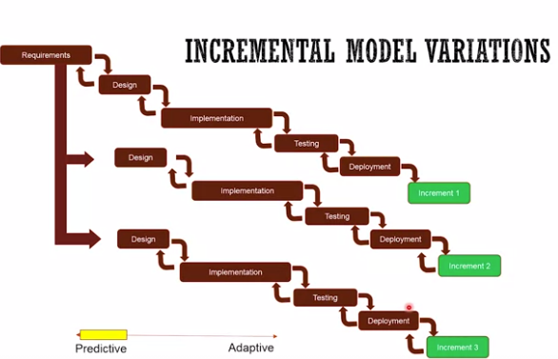
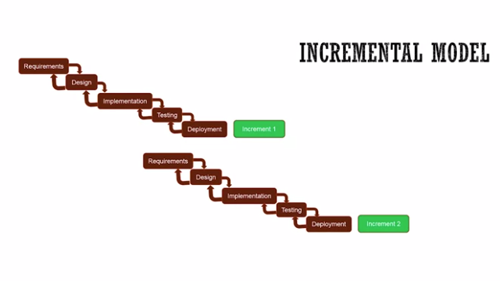
Plan-driven
Increments identified in advance
Agile
Early increments are identified and later will be decided on customer priorities.

Slide 13
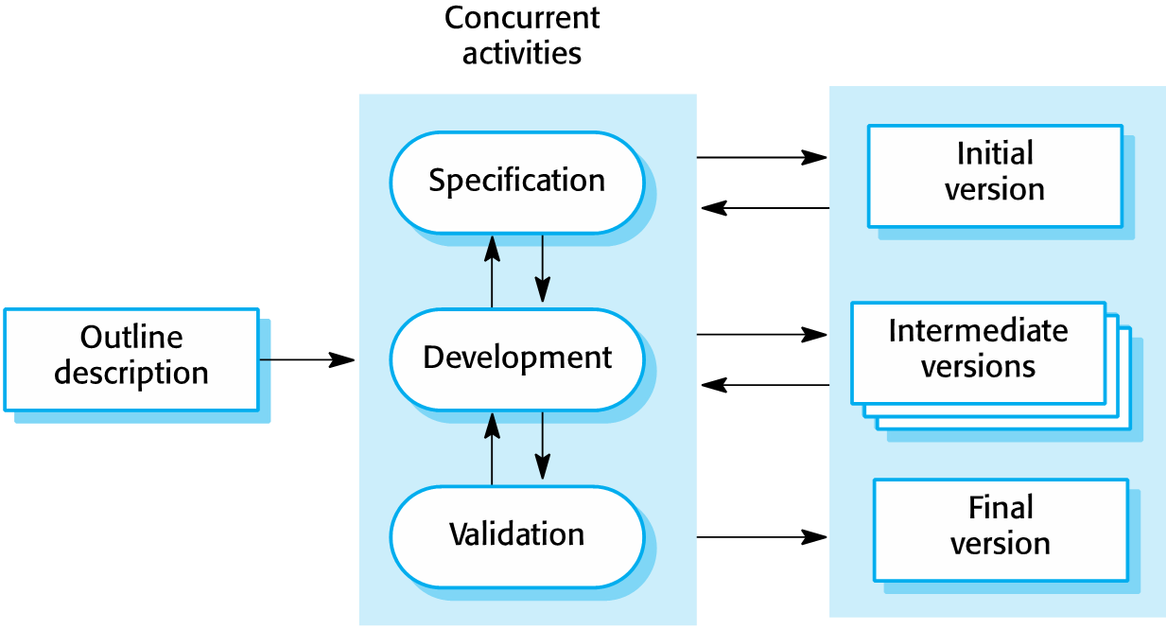
Incremental development

Slide 14
Incremental development benefits
The cost of accommodating changing customer requirements is reduced.
It is easier to get customer feedback on the development work that has been done.
More rapid delivery and deployment of useful software to the customer is possible.

Slide 15
Incremental development problems
The process is not visible.
Managers need regular deliverables to measure progress. If systems are developed quickly, it is not cost-effective to produce documents that reflect every version of the system.
System structure tends to degrade as new increments are added.
regular change tends to corrupt its structure. Incorporating further software changes becomes increasingly difficult and costly. regularly refactor the software is suggested

Slide 16
Example 01: Analyze the situation and suggest the Model
Let's say there is a solution company that basically experts in installing particular HR management system in big retailers.
So let's say company X needs to install a well known HR management system at a big retailer's headquarter. And they have done this install many times with similar retailers, big retailers before. So the question is, what model will fit best in this situation?
Well known problem
Well known solution
Waterfall Model

Slide 17
Example 02
A hospital wanted to automate their processes. And so they have hired a company that is expert in this area and has done similar automation for hospitals but not at this scale, So they have done it, but not at this scale. And then hospital management also wants consistency across the globe. So they want their processes to be consistent across the globe, but of course, every country has their own culture. And so they know that they'll be some new answers in different parts of the world, so they want to customize it over different places. And then they also realize that some of the places will greatly benefit from immediately deploying this kind of automation.

Slide 18
Analysis
Fairly known problem
Known solution but in big scale
Consistency
Incremental model

Slide 19
Integration and configuration
Based on software reuse where systems are integrated from existing components or application systems (sometimes called COTS -Commercial-off-the-shelf) systems.
Reused elements may be configured to adapt their behavior and functionality to a user’s requirements
Reuse is now the standard approach for building many types of business system

Slide 20
Types of reusable software
Based on software reuse where systems are integrated from existing components or application systems (sometimes called COTS -Commercial-off-the-shelf) systems).
Reused elements may be configured to adapt their behavior and functionality to a user’s requirements.
Reuse is now the standard approach for building many types of business system.

Slide 21
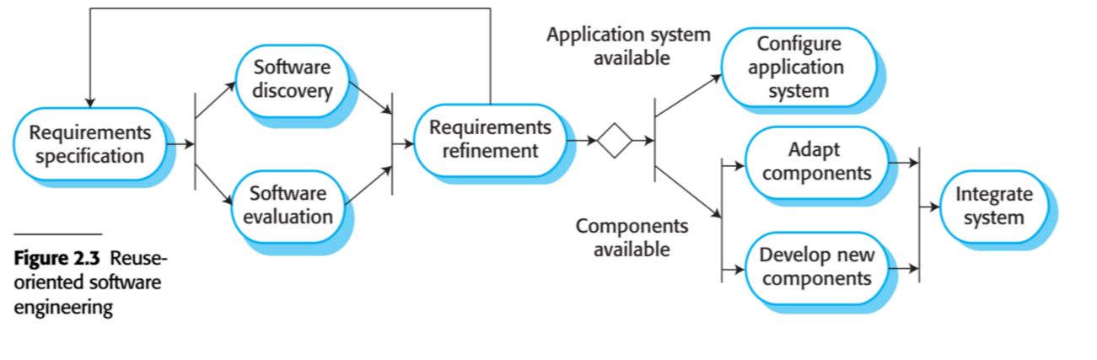
Key process stages
Requirements specification
Software discovery and evaluation
Requirements refinement
Application system configuration
Component adaptation and integration

Slide 22




Advantages and disadvantages
Reduced costs and risks as less software is developed from scratch
Faster delivery and deployment of system
But requirements compromises are inevitable so system may not meet real needs of users
Loss of control over evolution of reused system elements

Slide 23
Process activities

Slide 24
Process activities
The four basic process activities of specification, development, validation and evolution are organized differently in different development processes.
For example, in the waterfall model, they are organized in sequence, whereas in incremental development they are interleaved.

Slide 25
1.Software specification
The process of establishing what services are required and the constraints on the system’s operation and development.
Requirements engineering process:
1.Requirements elicitation and analysis
What do the system stakeholders require or expect from the system?
Project objectives and boundaries
Vision and scope document
2.Requirements specification
Defining the requirements in detail
Business requirements
User requirements
System requirements
3.Requirements validation
Checking the validity of the requirements.
Test-cases often reveals ambiguity.
SRS inspection by developers, testers.

Slide 26
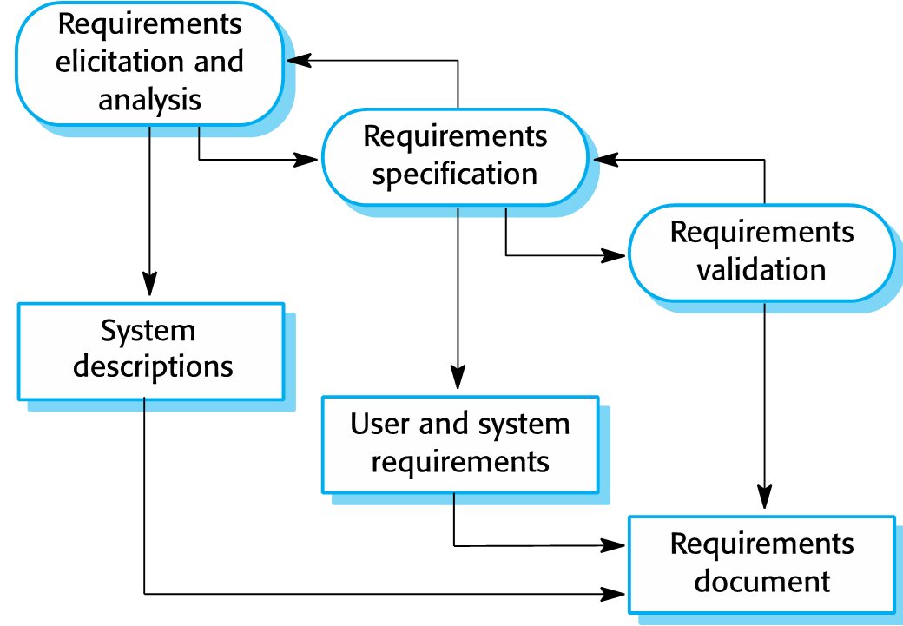
The Requirements Engineering process

Slide 27
2.Software design and implementation
The process of converting the system specification into an executable system.
Software design:
Design a software structure that realizes the specification
Implementation:
Translate this structure into an executable program
The activities of design and implementation are closely related and may be inter-leaved.

Slide 28
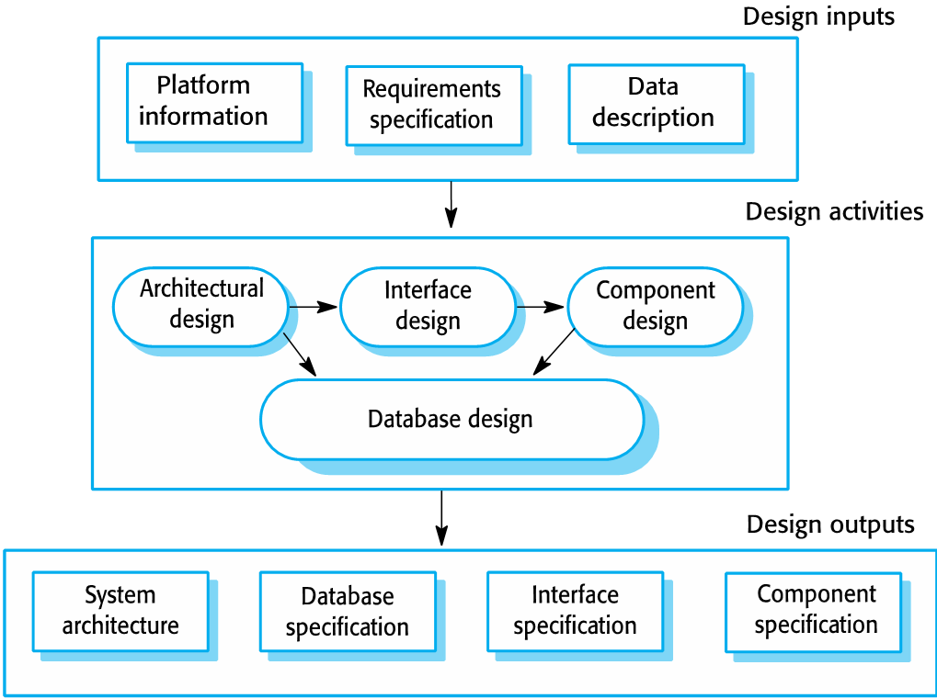
A general model of the design process

Slide 29
2a.Design activities
Architectural design:
where you identify the overall structure of the system, the principal components (subsystems or modules), their relationships and how they are distributed.
Database design:
where you design the system data structures and how these are to be represented in a database.
Interface design:
where you define the interfaces between system components.
Component selection and design
where you search for reusable components. If unavailable, you design how it will operate.

Slide 30
2b.System implementation
The software is implemented either by developing a program or programs or by configuring an application system.
Design and implementation are interleaved activities for most types of software system.
Programming is an individual activity with no standard process.
Debugging is the activity of finding program faults and correcting these faults.

Slide 31
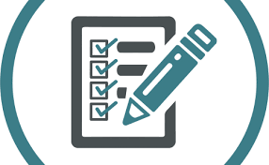
3.Software validation
Verification and validation (V & V) is intended to show that a system conforms to its specification and meets the requirements of the system customer.
Involves checking and review processes and system testing.
System testing involves executing the system with test cases that are derived from the specification of the real data to be processed by the system.
Testing is the most commonly used V & V activity.

Slide 32
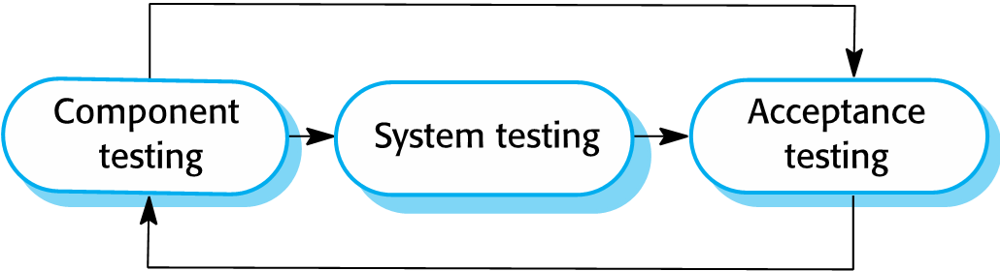
Stages of testing

Slide 33
Testing stages
Component testing:
Individual components are tested independently;
Components may be functions or objects or coherent groupings of these entities.
System testing:
Testing of the system as a whole. Testing of emergent properties is particularly important.
Customer testing:
Testing with customer data to check that the system meets the customer’s needs.

Slide 34
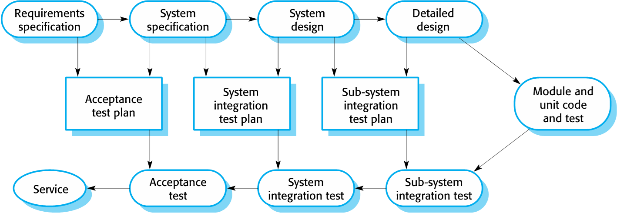
Testing phases in a plan-driven software process (V-model)

Slide 35
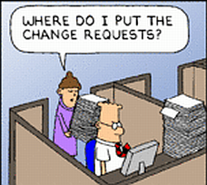
Software evolution
Software is inherently flexible and can change.
As requirements change through changing business circumstances, the software that supports the business must also evolve and change.

Slide 36
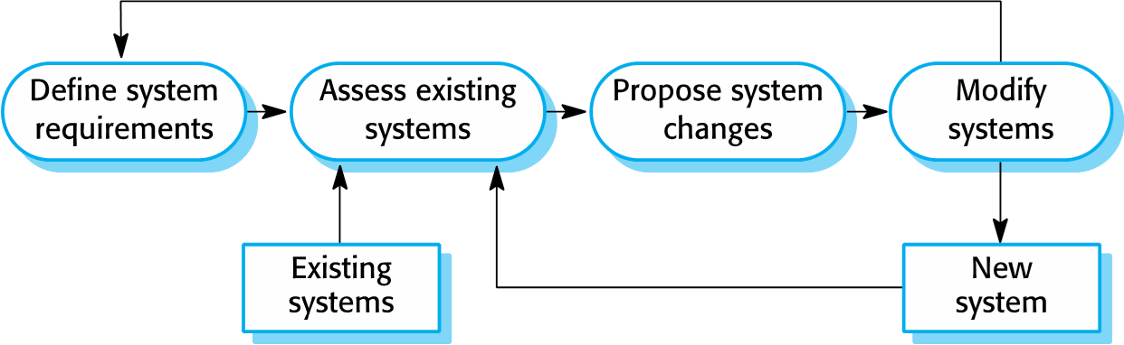
System evolution

Slide 37
Coping with change

Slide 38

Coping with change
Change is inevitable in all large software projects.
Business changes lead to new and changed system requirements.
New technologies open up new possibilities for improving implementations.
Changing platforms require application changes.

Slide 39
Approaches to reduce the costs of rework
Change anticipation:
Where the software process includes activities that can anticipate possible changes before significant rework is required.
For example, a prototype system may be developed to show some key features of the system to customers.
2. Change tolerance:
Where the process is designed so that changes can be accommodated at relatively low cost.
This normally involves some form of incremental development.

Slide 40
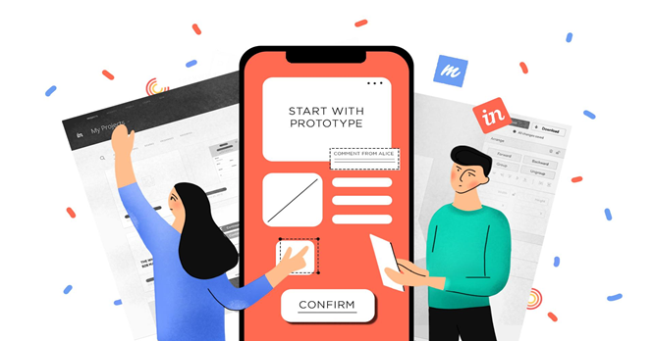
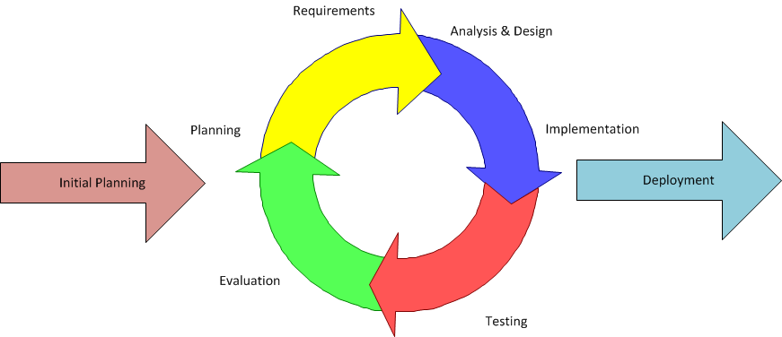
Two Ways of Coping with changing requirements
System prototyping, where a version of the system or part of the system is developed quickly to check the customer’s requirements and the feasibility of design decisions. This approach supports change anticipation.
Incremental delivery, where system increments are delivered to the customer for comment and experimentation. This supports both change avoidance and change tolerance

Slide 41
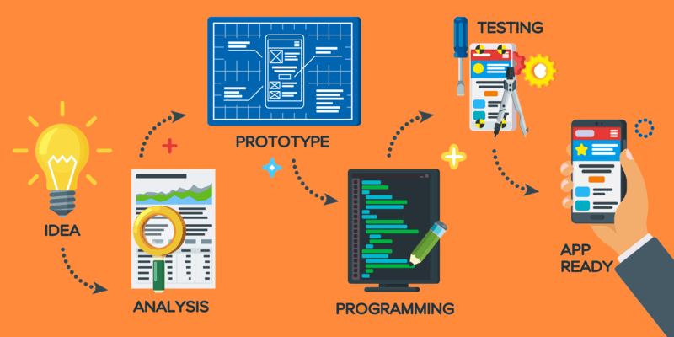
Software prototyping
A prototype is an initial version of a system used to demonstrate concepts and try out design options.
A prototype can be used in:
The requirements engineering process to help with requirements elicitation and validation;
In design processes to explore options and develop a UI design;
In the testing process to run back-to-back tests

Slide 42

Benefits of prototyping
Improved system usability.
A closer match to users’ real needs.
Improved design quality.
Improved maintainability.
Reduced development effort.

Slide 43
The process of prototype development

Slide 44

Prototype development
May be based on rapid prototyping languages or tools
May involve leaving out functionality
Prototype should focus on areas of the product that are not well-understood;
Error checking and recovery may not be included in the prototype;
Focus on functional rather than non-functional requirements such as reliability and security

Slide 45
Throw-away prototypes
Prototypes should be discarded after development as they are not a good basis for a production system:
It may be impossible to tune the system to meet non-functional requirements;
Prototypes are normally undocumented;
The prototype structure is usually degraded through rapid change;
The prototype probably will not meet normal organizational quality standards

Slide 46
Incremental delivery
Rather than deliver the system as a single delivery, the development and delivery is broken down into increments with each increment delivering part of the required functionality.
User requirements are prioritised, and the highest priority requirements are included in early increments.
Once the development of an increment is started, the requirements are frozen though requirements for later increments can continue to evolve.

Slide 47
Incremental development and delivery
Incremental development
Develop the system in increments and evaluate each increment before proceeding to the development of the next increment;
Normal approach used in agile methods;
Evaluation done by user/customer proxy.
Incremental delivery
Deploy an increment for use by end-users;
More realistic evaluation about practical use of software;
Difficult to implement for replacement systems as increments have less functionality than the system being replaced

Slide 48
Incremental delivery

Slide 49
Incremental delivery advantages
Customer value can be delivered with each increment, so system functionality is available earlier.
Early increments act as a prototype to help elicit requirements for later increments.
Lower risk of overall project failure.
The highest priority system services tend to receive the most testing.

Slide 50
Incremental delivery problems
Most systems require a set of basic facilities that are used by different parts of the system.
As requirements are not defined in detail until an increment is to be implemented, it can be hard to identify common facilities that are needed by all increments.
The essence of iterative processes is that the specification is developed in conjunction with the software.
However, this conflicts with the procurement model of many organizations, where the complete system specification is part of the system development contract.

Slide 51
Process improvement

Slide 52
Process improvement
Many software companies have turned to software process improvement as a way of enhancing the quality of their software, reducing costs or accelerating their development processes.
Process improvement means understanding existing processes and changing these processes to increase product quality and/or reduce costs and development time.

Slide 53
Approaches to improvement
The process maturity approach, which focuses on improving process and project management and introducing good software engineering practice.
The level of process maturity reflects the extent to which good technical and management practice has been adopted in organizational software development processes.
The agile approach, which focuses on iterative development and the reduction of overheads in the software process.
The primary characteristics of agile methods are rapid delivery of functionality and responsiveness to changing customer requirements.

Slide 54
The process improvement cycle

Slide 55
Process improvement activities
Process measurement
You measure one or more attributes of the software process or product. These measurements forms a baseline that helps you decide if process improvements have been effective.
Process analysis
The current process is assessed, and process weaknesses and bottlenecks are identified. Process models (sometimes called process maps) that describe the process may be developed.
Process change
Process changes are proposed to address some of the identified process weaknesses. These are introduced and the cycle resumes to collect data about the effectiveness of the changes.

Slide 56
Process measurement
Wherever possible, quantitative process data should be collected
However, where organisations do not have clearly defined process standards this is very difficult as you don’t know what to measure. A process may have to be defined before any measurement is possible.
Process measurements should be used to assess process improvements
But this does not mean that measurements should drive the improvements. The improvement driver should be the organizational objectives.

Slide 57
Process metrics
Time taken for process activities to be completed
E.g. Calendar time or effort to complete an activity or process.
Resources required for processes or activities
E.g. Total effort in person-days.
Number of occurrences of a particular event
E.g. Number of defects discovered.

Slide 58
Capability maturity levels

Slide 59
The SEI capability maturity model
Initial
Essentially uncontrolled , processes are unpredictable
Managed
Product management procedures defined and used at project level.
Defined
Process management procedures and strategies defined and used at organization level.
Quantitatively Managed
Processes are controlled using statistical techniques.
Optimising
Process improvement strategies defined, processes are continuously improved.

Slide 60
End

